Slide 1




Introduction in
PROGRAMMING
NAVITHA GUNALAN
INTRODUCTION TO PROGRAMMING

Slide 2
TOPIC 1: Overview of Programming
NAVITHA GUNALAN
INTRODUCTION TO PROGRAMMING

Slide 3

COURSE LEARNING OUTCOME (CLO)
1.1. Roles of hardware and software in a computing system
1.2. Basic design of a modern computer
1.3. Form and function of computer programming language
Work together to execute instructions, process data, store information, and interact with users, enabling the computer to perform a wide range of tasks efficiently.
Hardware and software are two essential components of a computing system that work together to enable the functioning of computers and other electronic devices.
They determine how programmers write code and how computers interpret and execute that code.
NAVITHA GUNALAN
INTRODUCTION TO PROGRAMMING

Slide 4

1.1. ROLES OF HARDWARE AND SOFTWARE IN A COMPUTING SYSTEM
Computers can perform such a wide variety of tasks because they can be programmed. This means that computers are not designed to do just one job, but to do any job that their programs tell them to do. A program is a set of instructions that a computer follows to perform a task.
Hardware
Software
NAVITHA GUNALAN
INTRODUCTION TO PROGRAMMING

Slide 5
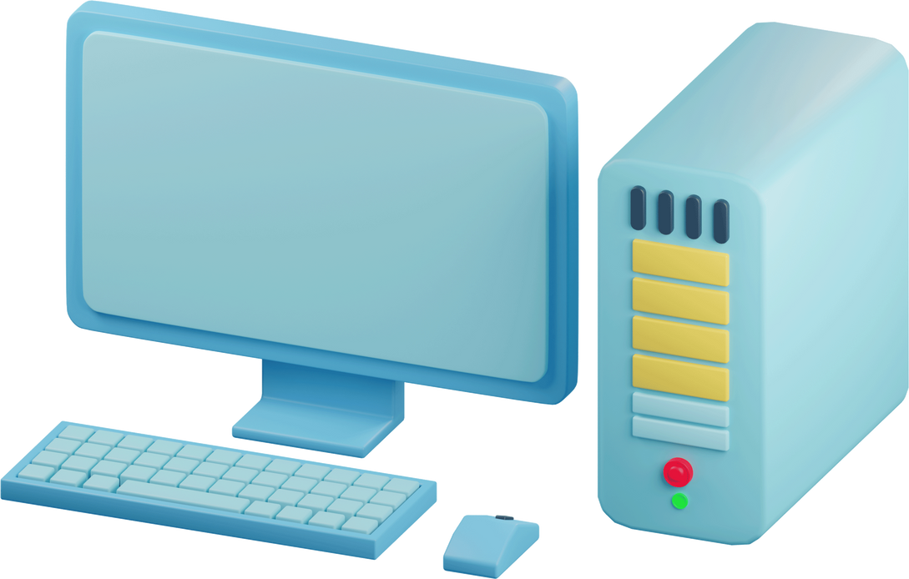
HARDWARE
The term hardware refers to all of the physical devices, or components, of which a computer is made. A computer is not one single device, but a system of devices that all work together.
Computer System consists of the following major components:
• The central processing unit (CPU)
• Main memory
NAVITHA GUNALAN
INTRODUCTION TO PROGRAMMING

Slide 6
COMPUTER SYSTEM COMPONENTS:
The central processing unit (CPU)
Main memory
Main memory is commonly known as random-access memory, or RAM. It is called this
because the CPU is able to quickly access data stored at any random location in RAM.
The CPU is often referred to as the "brain" of the computer because it carries out most of the actual computing tasks.
NAVITHA GUNALAN
INTRODUCTION TO PROGRAMMING

Slide 7
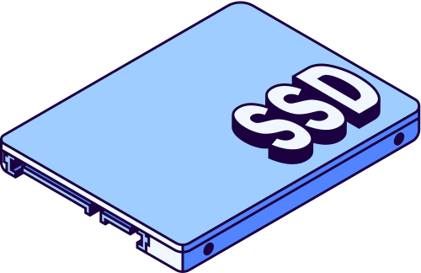
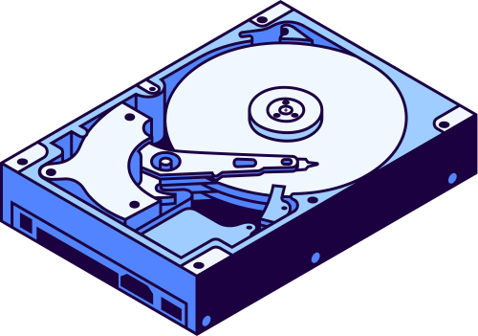
SECONDARY STORAGE DEVICE
Secondary storage is a type of memory that can hold data for long periods of time, even when there is no power to the computer.
The most common type of secondary storage device is the disk drive. A traditional disk drive stores data by magnetically encoding it onto a spinning circular disk.
External storage devices, which connect to one of the computer’s communication ports, are also available. External storage devices can be used to create backup copies of important data or to move data to another computer.
NAVITHA GUNALAN
INTRODUCTION TO PROGRAMMING

Slide 8


INPUT AND OUTPUT DEVICES
INPUT DEVICE
Input is any data the computer collects from people and from other devices. The component
that collects the data and sends it to the computer is called an input device.
OUTPUT DEVICE
Output is any data the computer produces for people or for other devices. It might be
a sales report, a list of names, or a graphic image. The data is sent to an output device,
which formats and presents it.
NAVITHA GUNALAN
INTRODUCTION TO PROGRAMMING

Slide 9

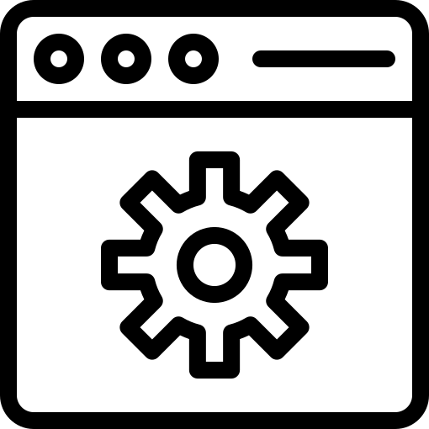
SOFTWARE
SYSTEM SOFTWARE
The programs that control and manage the basic operations of a computer are generally
referred to as system software.
APPLICATION SOFTWARE
Programs that make a computer useful for everyday tasks are known as application software
NAVITHA GUNALAN
INTRODUCTION TO PROGRAMMING

Slide 10


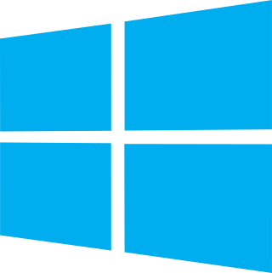
SYSTEM SOFTWARE
Operating Systems : An operating system is the most fundamental set of programs ona computer. The operating system controls the internal operations of the computer’s hardware, manages all of the devices connected to the computer, allows data to be saved to and retrieved from storage devices, and allows other programs to run on the computer. Popular operating systems computers include Windows, macOS, and Linux.mobile devices include Android and iOS.
Utility Programs : A utility program performs a specialized task that enhances the computer’s
operation or safeguards data. Examples of utility programs are virus scanners, file compression programs, and data backup programs.
Software Development : Tools Software development tools are the programs that programmersuse to create, modify, and test software. Assemblers, compilers, and interpreters are examples of programs that fall into this category.
NAVITHA GUNALAN
INTRODUCTION TO PROGRAMMING

Slide 11
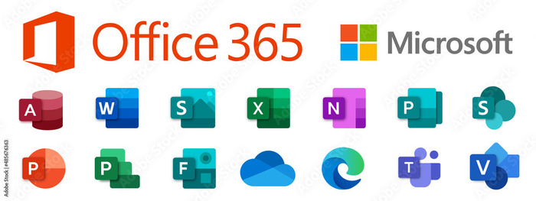
APPLICATION SOFTWARE
These are the programs that people normally spend most of their time running on
their computers. Is a computer program designed to carry out a specific task other than one relating to the operation of the computer itself, typically to be used by end-users.
Application software can be classified into two main categories: stand-alone software and web-based software.
Stand-alone software: installed on a user's computer and can be used without an internet connection. Ex: Microsoft Office, Adobe Photoshop, and Spotify.
Web-based software : is accessed and used through a web browser.
Ex: Google Docs, Gmail, and Netflix.
NAVITHA GUNALAN
INTRODUCTION TO PROGRAMMING

Slide 12

1.2. BASIC DESIGN OF A MODERN COMPUTER
HOW COMPUTERS STORE DATA
A computer’s memory is divided into tiny storage locations known as bytes. One byte is only enough memory to store a letter of the alphabet or a small number. The term bit stands for binary digit.
NAVITHA GUNALAN
INTRODUCTION TO PROGRAMMING

Slide 13
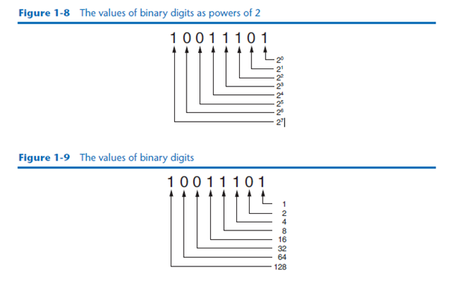
STORING NUMBERS
A bit can be used in a very limited way to represent numbers. In computer systems, a bit that is turned off represents the number 0, and a bit that is turned on represents the number 1. In the binary numbering system (or binary, as it is usually called), all numeric values are written as sequences of 0s and 1s. Here is an example of a number that is written in binary: 10011101
NAVITHA GUNALAN
INTRODUCTION TO PROGRAMMING

Slide 14
1.3. FORM AND FUNCTION OF COMPUTER PROGRAMMING LANGUAGE
HOW A PROGRAM WORKS
A computer’s CPU can only understand instructions that are written in machine language. Because people find it very difficult to write entire programs in machine language, other programming languages have been
invented.
NAVITHA GUNALAN
INTRODUCTION TO PROGRAMMING

Slide 15
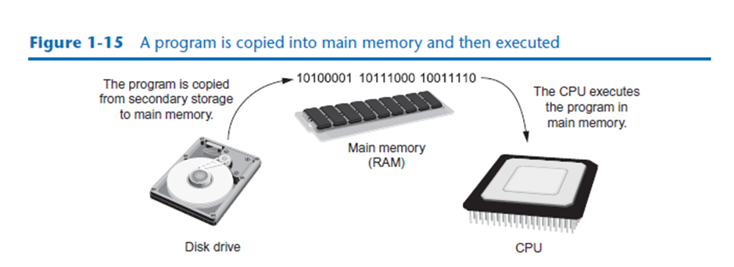
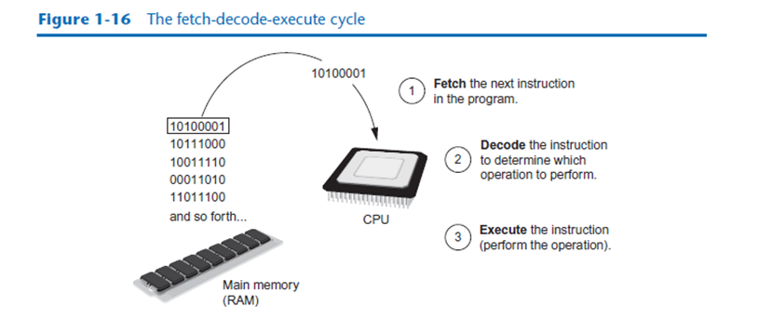
FETCH-DECODE-EXECUTE CYCLE
Fetch. A program is a long sequence of machine language instructions. The first step of the cycle is to fetch, or read, the next instruction from memory into the CPU.
Decode. A machine language instruction is a binary number that represents a command that tells the CPU to perform an operation. In this step, the CPU decodes the instruction that was just fetched from memory, to determine which operation it should perform.
Execute. The last step in the cycle is to execute, or perform, the operation.
NAVITHA GUNALAN
INTRODUCTION TO PROGRAMMING

Slide 16
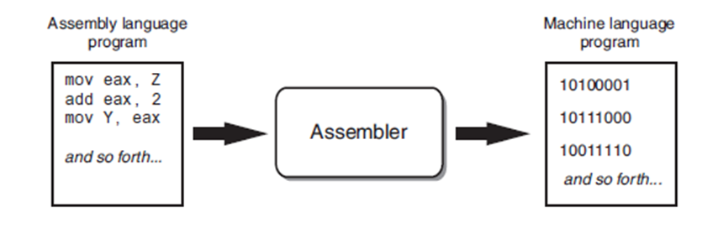
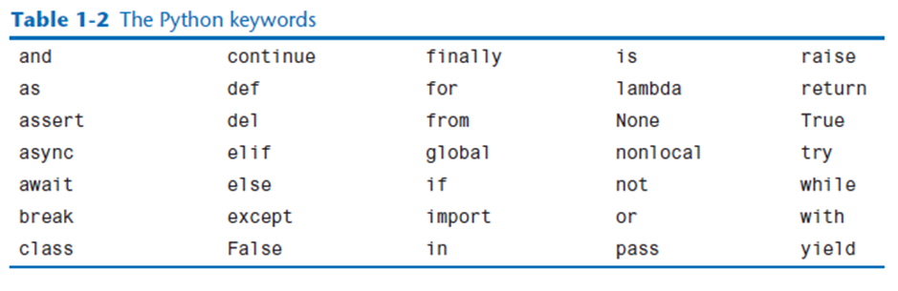
NAVITHA GUNALAN
INTRODUCTION TO PROGRAMMING

Slide 17
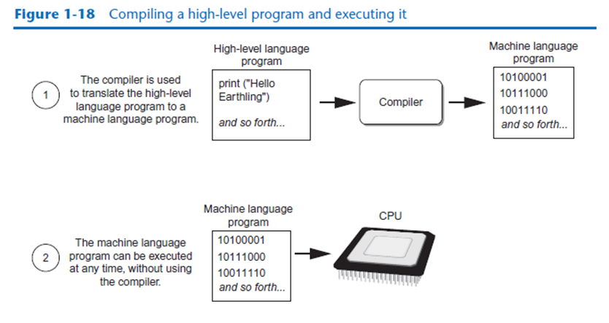
COMPILER
A compiler is a program that translates a high-level language program into a separate machine language program. The machine language program can then be executed any time it is needed.
NAVITHA GUNALAN
INTRODUCTION TO PROGRAMMING

Slide 18
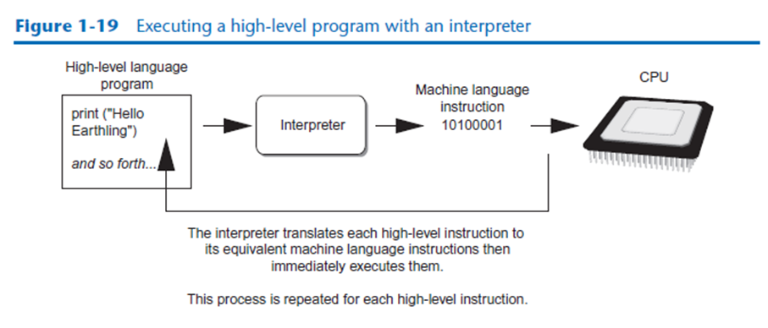
INTERPRETER
The Python language uses an interpreter, which is a program that both translates and
executes the instructions in a high-level language program. As the interpreter reads
each individual instruction in the program, it converts it to machine language instructions then immediately executes them.
NAVITHA GUNALAN
INTRODUCTION TO PROGRAMMING

Slide 19
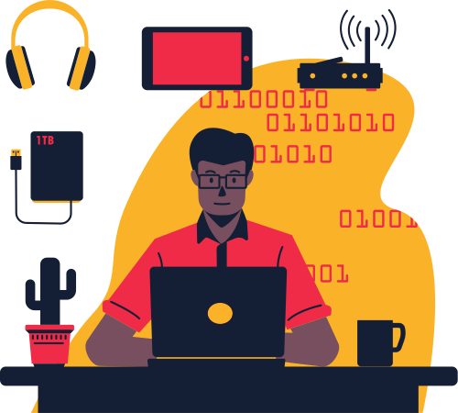

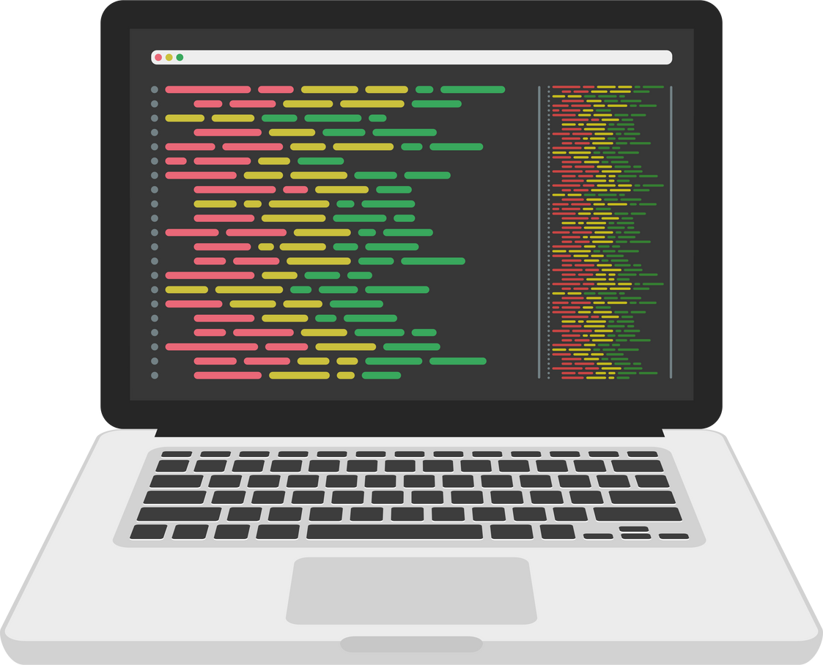
The statements that a programmer writes in a high-level language are called source code, or simply code.
Typically, the programmer types a program’s code into a text editor then saves the code in a file on the computer’s disk.
A syntax error is a mistake such as a misspelled keyword, a missing punctuation character, or the incorrect use of an operator.
When this happens, the compiler or interpreter displays an error message indicating that the program contains a syntax error.

Slide 20
USING PYTHON
The Python interpreter can run Python programs that are saved in files or interactively execute Python statements that are typed at the keyboard. Python comes with a program named IDLE that simplifies the process of writing, executing, and testing programs.
IDLE
Integrated Development
Environment
Python programming is fun! on the screen:
print('Python programming is fun!')
Python programming is fun!
print('To be or not to be')
To be or not to be
print('That is the question.') Enter
That is the question.
NAVITHA GUNALAN
INTRODUCTION TO PROGRAMMING

Slide 21



NAVITHA GUNALAN
INTRODUCTION TO PROGRAMMING

